Slide 1
Noise-aware Gaussian Processes, Bayesian Inference, and Structured Gaussian Processes
Sergei V. Kalinin

Slide 2
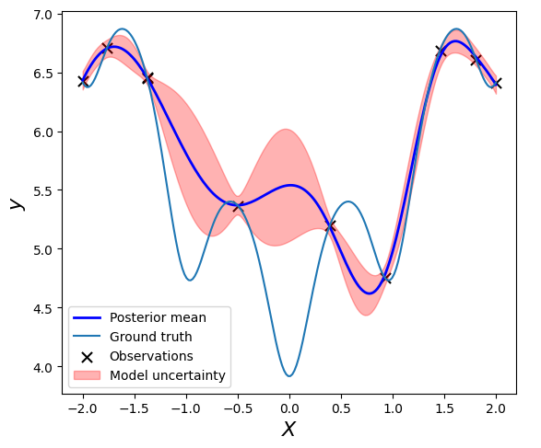
What have we learned from lecture 2
Gaussian Process
Kernel and kernel parameters
Kernel Priors
Noise Priors
Posteriors
Bayesian Optimization
Bayesian Optimization based on Gaussian Process
Acquisition Functions
Cost-award BO

Slide 3


But what about noises?
Gaussian Process learns the noise and kernel function while exploring parameter space. What if the noise level is not constant?
$f\left(x\right)∼𝒢𝒫\left(m\left(x\right),k\left(x,x^{′}\right)\right)$
$$y\left(x\right)= f\left(x\right)+σ(x)$$
Solution: heteroscedastic GP uses
one GP for function, and
another GP for the noise
Note that we can create models for function and noise (structured GP)

Slide 4
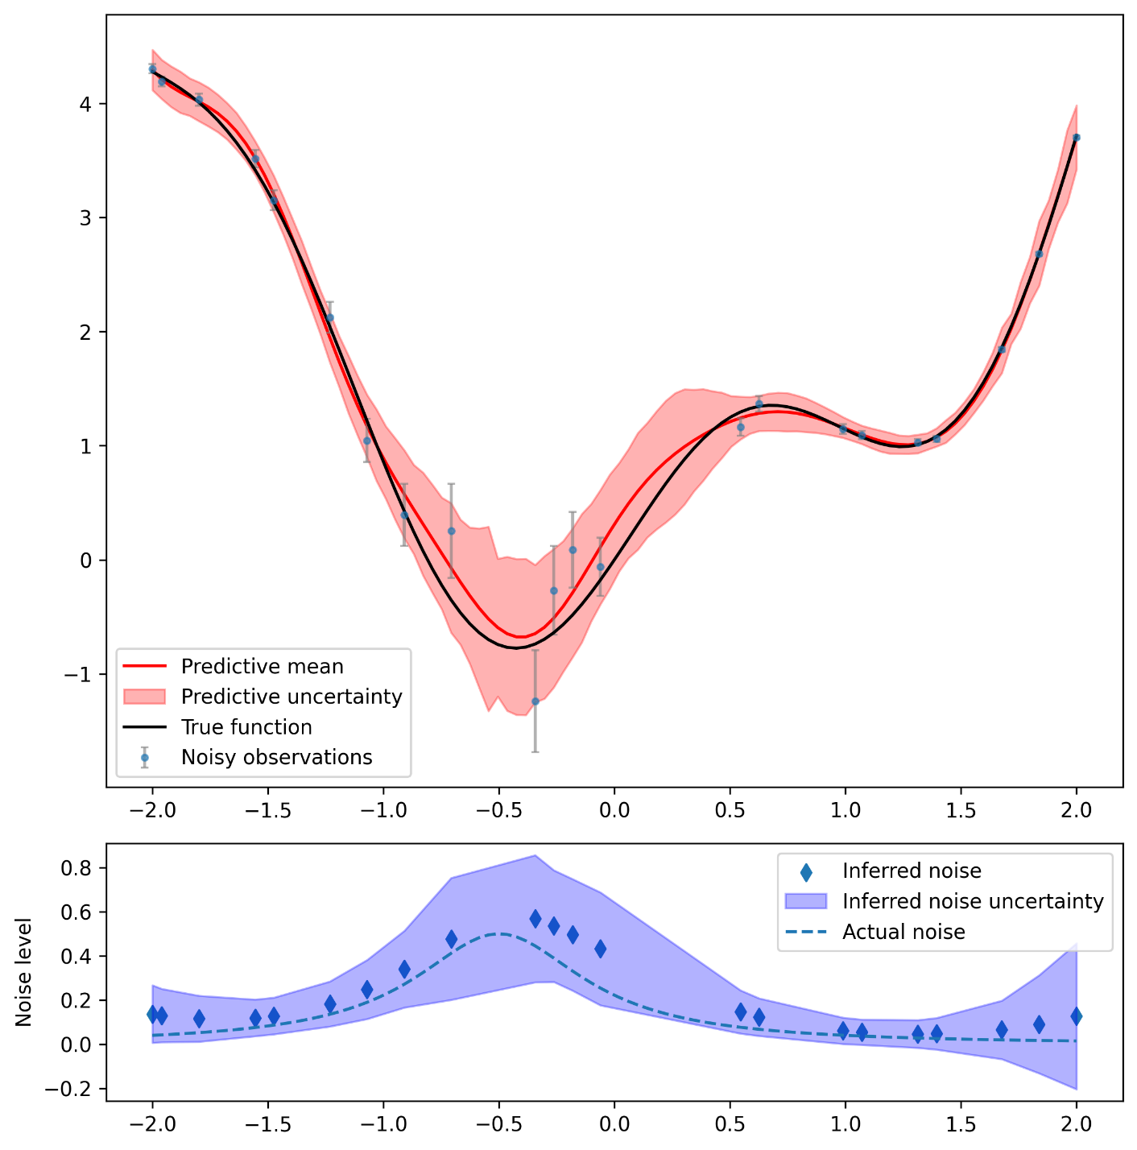
Heteroscedastic GP

Slide 5
But what if the noise can be measured?
In many experimental scenarios, the experiment can be configured so that the noise can be measured (or estimated).
For example, it is often easier to measure multiple times (indentation curves, spectra, etc) at one location rather then move around
Alternatively, noise can be estimated from single measurement.
Note that we still need noise model even when the noise is measured, since we need to have an estimate of noise at the yet-unmeasured locations

Slide 6
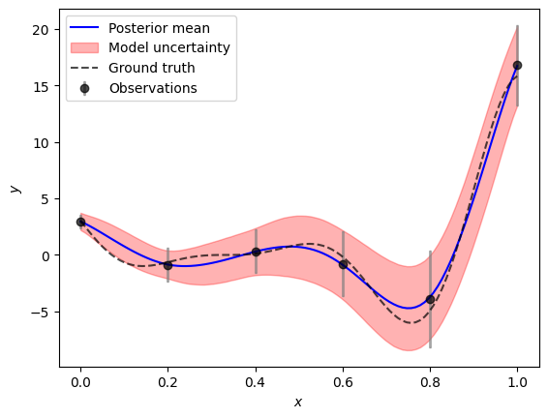
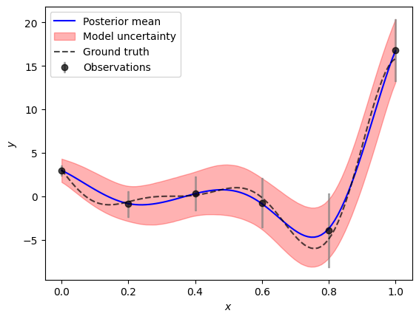
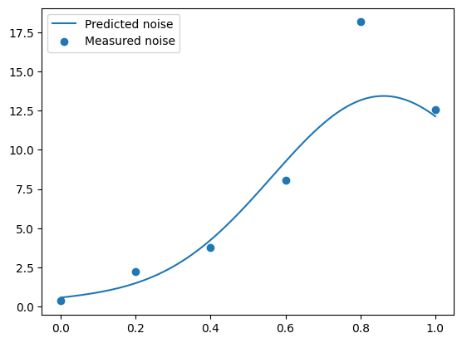
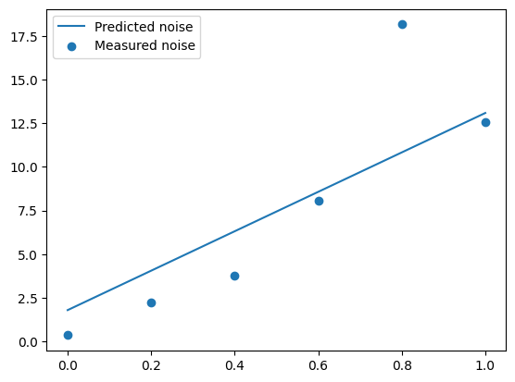
Measured Noise GP
GP regression
Linear regression

Slide 7
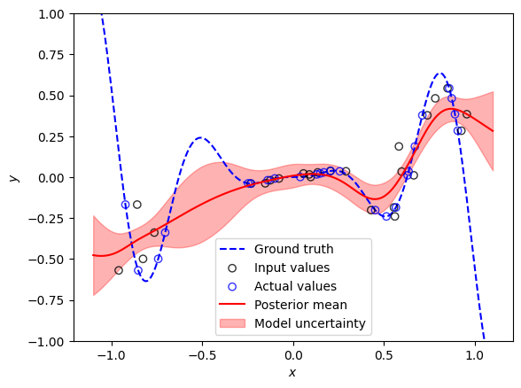
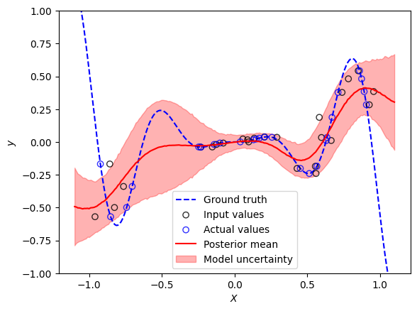
What if the measurement location in uncertain?
Simple GP
Uncertain Measurement

Slide 8
What about functions fits?

Slide 9
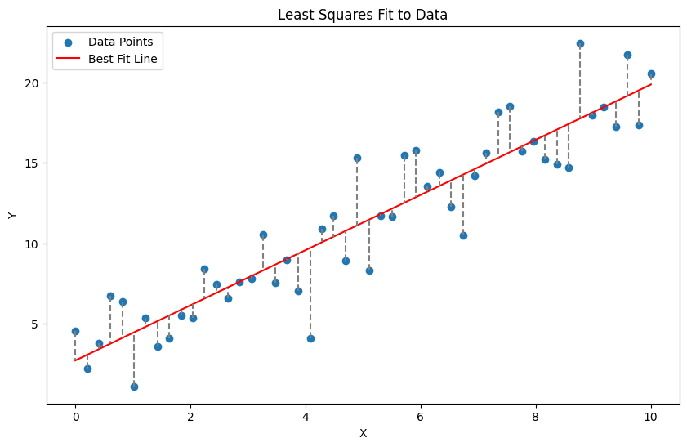
Let’s start linear!
Least Squares Fitting: a method to determine the best-fitting line through a set of points.
Objective: Minimize the sum of the squares of the differences (residuals) between observed and predicted values.
We have data, meaning collection of points (x_{i}, y_{i})
We choose function, here y = a + b x
We calculate total error, L(a,b) = ∑( (y_{i} – (a + b x_{i}))²)
We find parameters a, b for which L(a,b) is minimal

Slide 10
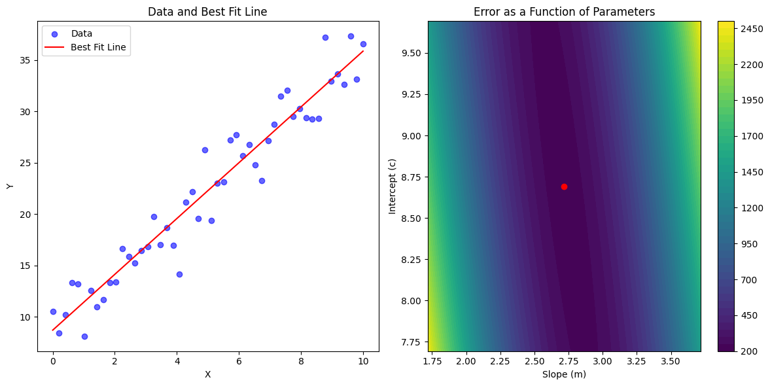
Let’s start linear!

Slide 11
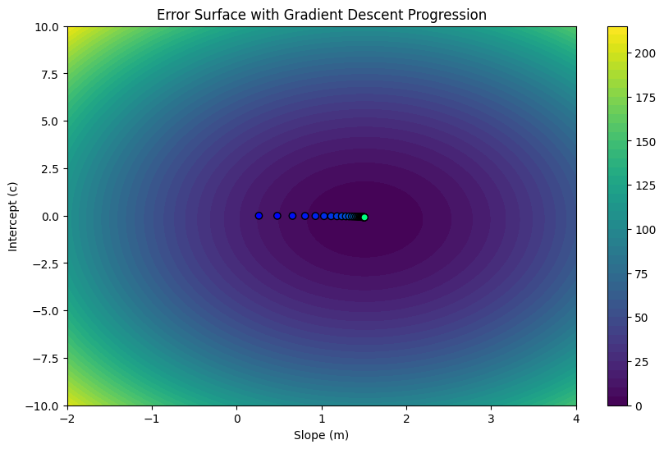
Finding minimum with gradient descent

Slide 12
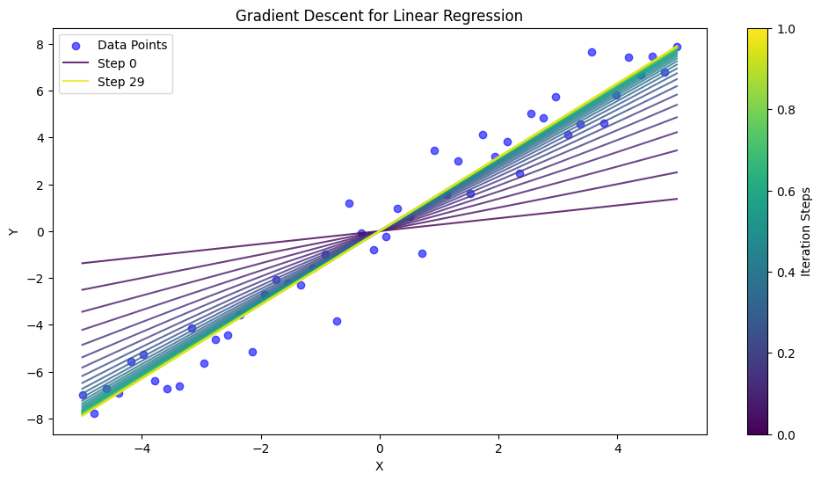
Finding minimum with gradient descent

Slide 13
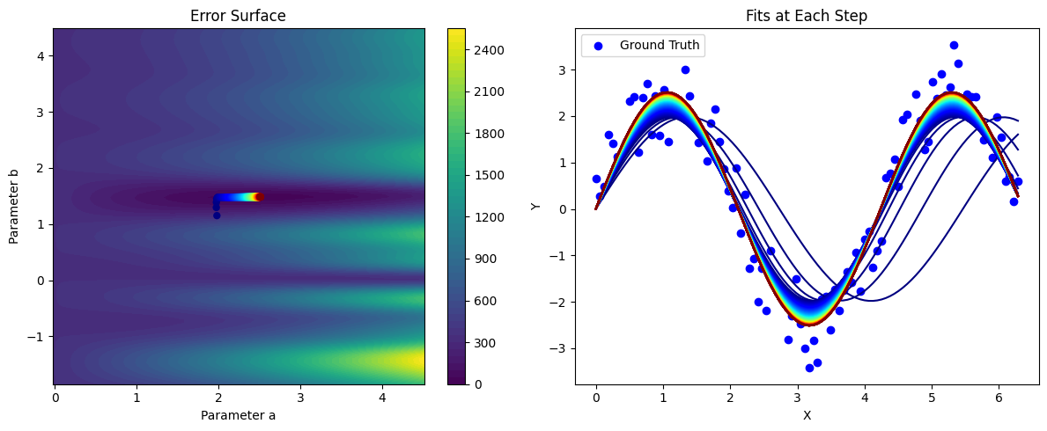
The sine that works

Slide 14
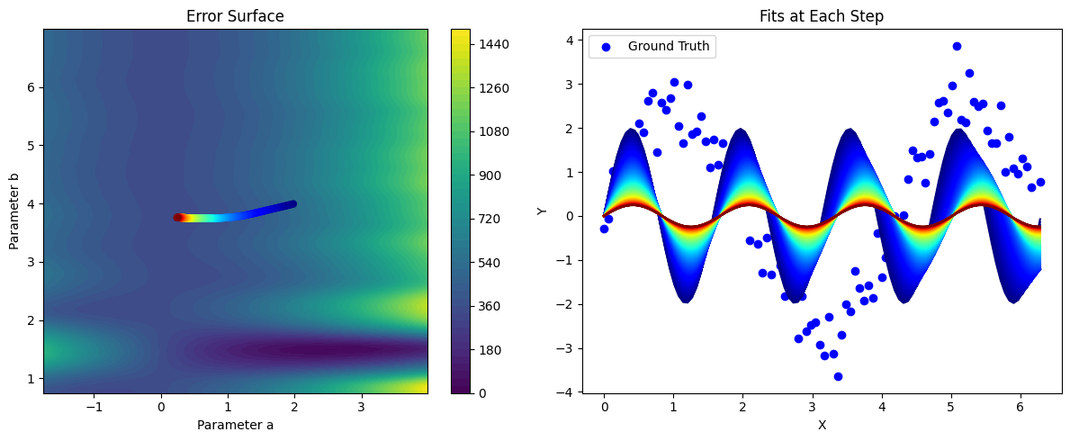
The sine that doesn’t

Slide 15
What will we learn: Bayesian Inference Detour:
Bayesian Inference
Prior Distribution
Posterior Distribution
Least Square Fit
WAIC

Slide 16
Colab Bayesian Inference

Slide 17
Automated Experiment: … as a scientist…
Bayesian optimization:
1. Works only in low-dimensional spaces 2. The correlations are defined by the kernel function (very limiting) 3. We do not use any knowledge about physics of the system 4. We do not use cheap information available during the experiment (proxies)

Slide 18
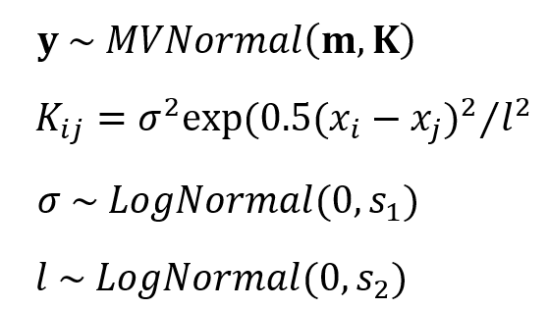
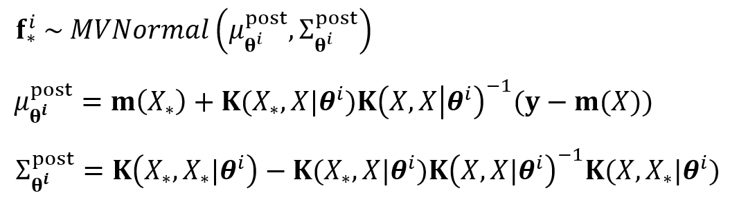
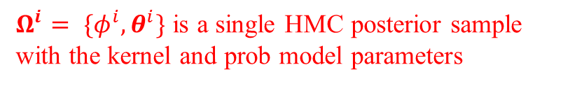
GP Augmented with Structural model
Define a probabilistic model:
We substitute a constant GP prior mean function m with a structured probabilistic model of the expected system’s behavior.
This probabilistic model reflects our prior knowledge about the system, but it does not have to be precise.
The model parameters are inferred together with the kernel parameters via the Hamiltonian Monte Carlo.
The fully Bayesian treatment of the model allows additional control over the optimization via the selection of priors for the model parameters.
Prediction on new data $X_{∗}$:
replaced with
$Ω^{i}= \{φ^{i},θ^{i}\}$ is a single HMC posterior sample with the kernel and prob model parameters

Slide 19
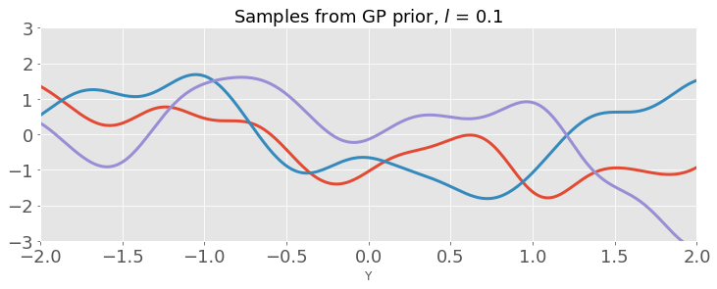
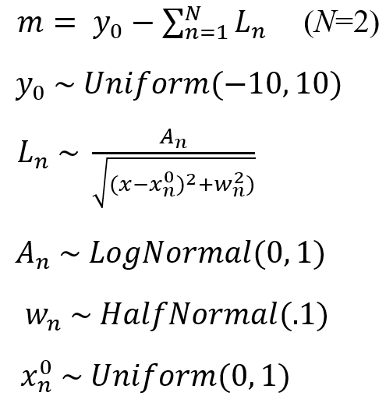
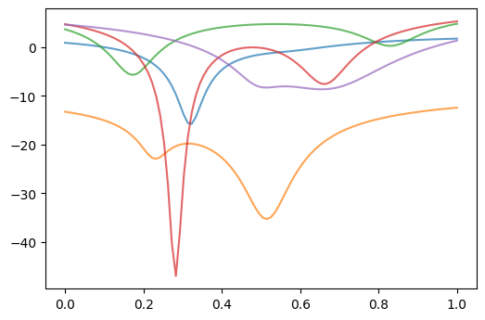
GP Augmented with Structural model
Prior predictive distribution: GP
Probabilistic model
Prior predictive distribution: sGP
This model simply tells us that there are two minima in our data but does not assume to have any prior knowledge about their relative depth, width, or distance

